Slide 1

DryadSynth: Advancing Program Synthesis through Hybrid Techniques
Xiaokang Qiu
Hanyang University, May 16, 2025

Slide 2





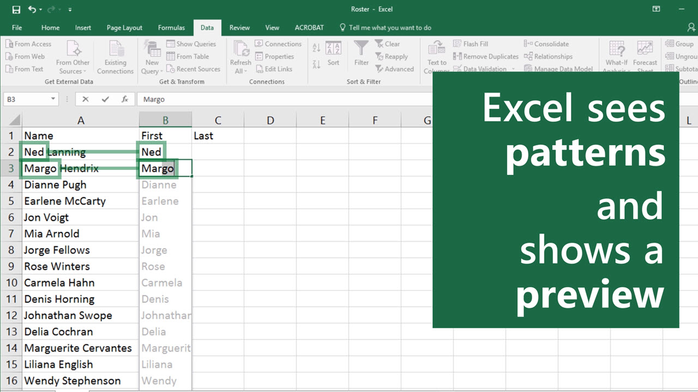
Program Synthesis
Program Synthesizer
User intent
Program
Spreadsheet Programming
Computer-aided Education
Code Completion
Notes:
Program synthesis is the task that aims to generate programs automatically from user-provided specifications. In recent year, program synthesis has attracted significant attention and has a surge of practical efforts in many applications, including spreadsheet programming, computer-aided education, software engineering, etc.
For instance, the FlashFill system embedded in Microsoft Excel makes it much easier for users to handle string manipulation tasks.

Slide 3



Synthesis
Adaptive Concretization for Sketch [CAV’15,FMSD’17]
JSketch [FSE’15,OOPSLA’19]
Natural Synthesis [OOPSLA’17]
SyntRec [TACAS’17]
Retreet [PPoPP’21]
P4CGO [FMANO’24]
ClassInvGen [Arxiv’25]
Comparative Synthesis [HotNets’19, POPL’23]
Toshokan [SAS’22]
DryadSynth [PLDI’20, POPL’24, PLDI’25]
QED (MCM verification) [Arxiv’24]
Dryad Logic [POPL’11,SAS’11,VMCAI’19]
Pasket (Pattern Sketcher) [ICSE’16]
Natural Proofs [POPL’12,PLDI’13,PLDI’14]
User Interaction
Formal Guarantee

Slide 4
Syntax-Guided Synthesis (SyGuS)
Semantic specification
Program Synthesizer
Program
Syntactic constraints
(Hints for implementation, quantitative metrics, language restriction)
Notes:
Program synthesis is the task that aims to generate programs automatically from user-provided specifications. In recent year, program synthesis has attracted significant attention and has a surge of practical efforts in many applications, including spreadsheet programming, computer-aided education, software engineering, etc.
For instance, the FlashFill system embedded in Microsoft Excel makes it much easier for users to handle string manipulation tasks.

Slide 5

DryadSynth: A SyGuS Solver
Supports multiple theories
  CLIA
  INV
  BV
  String
Publications
  Reconciling Enumerative and Deductive Program Synthesis (PLDI 2020, CLIA)
  Enhanced Enumeration Techniques for Syntax-Guided Synthesis (POPL 2024, BV)
  A Concurrent Approach to String Transformation Synthesis (PLDI 2025, String)
Other solvers: CVC4/CVC5, Duet, EUSolver, LoopInvGen, Probe, Simba, etc.
Try DryadSynth at: https://cap.ecn.purdue.edu/dryadsynth
Notes:
Our cooperative synthesis algorithm is implemented as a sygus solver, called DryadSynth. The solver is publicly available. We evaluated DryadSynth on benchmarks with CLIA background theory from the latest sygus competition. The benchmarks come from three tracks of the competition, including synthesizing functions with standard CLIA grammar, synthesizing loop invariants and synthesizing functions with arbitrary grammars. It wound up with 715 benchmarks in total. The experiments are conducted on the StarExec platform which is also used by the competition. Each synthesis job is running on a node with a 30 minutes timeout. To evaluate the performance of DryadSynth, we compare our results with state-of-the-art sygus solvers, namely CVC4, EUSolver and loopinvgen. CVC4 and eusolver are two general purpose sygus solvers, while loopinvgen is designed for loop invariant synthesis.

Slide 6
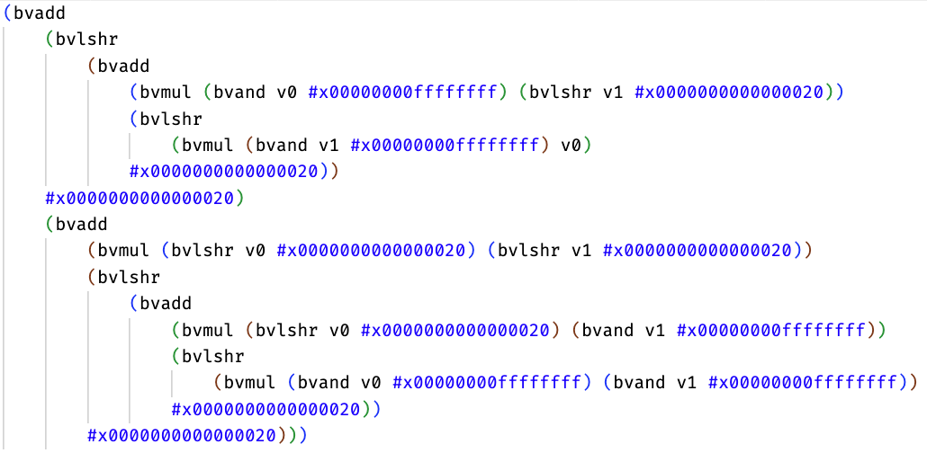
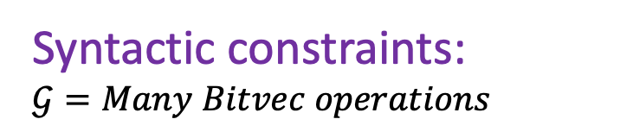

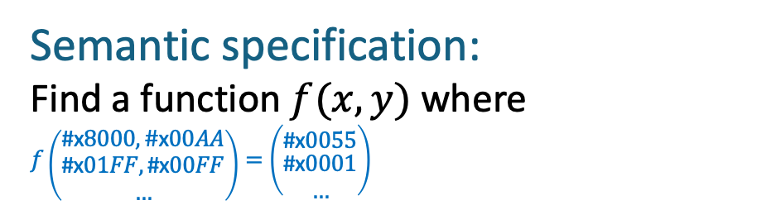

Hacker’s delight 25 in SyGuS-IF
Semantic specification:
Compute higher order half of product of bitvectors x and y.
Semantic specification:
Find a function $f(x,y)$ where
$$f\left({\text{\#}\text{x}8000,\#\text{x}00AA \atop \begin{aligned}\text{\#}\text{x}01FF,\text{\#}\#\text{x}00FF \\ …\end{aligned}}\right)=\left({\text{\#}\text{x}\text{0055} \atop \begin{aligned}\#\text{\#}\text{x}0001 \\ …\end{aligned}}\right)$$
Syntactic constraints:
$$𝒢=Many Bitvec operations$$
Syntactic constraints:
E :=
$x$ | $y$ | 0x0000 | 0x00ff | 0x0008 | …
| not E | E and E | E or E | E xor E
| neg E | E add E | E mul E
| E sub E | E udiv E | E sdiv E |
| E urem E | E srem E | E ashr E
| E << E | E >> E | ITE (E = 0, E, E)
Syntax-guided Synthesizer
$$f\left(x,y\right)≝$$
Notes:
Syntax-guided synthesis aims to find a program satisfying not only a semantic specification but also a syntactic specification. The semantic specification describes what the program is supposed to compute, for example, finding the max of three integers. And the syntactic constraint describes which operators can be used in the implementation. Here shows a grammar having standard linear arithmetic operators with conditionals. The expected output program should satisfy both two specifications.

Slide 7

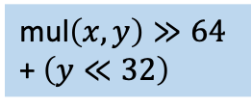







Synthesis by Bottom-Up Enumeration
Semantic specification:
$$f\left({\text{\#}\text{x}8000,\#\text{x}00AA \atop \begin{aligned}\text{\#}\text{x}01FF,\text{\#}\#\text{x}00FF \\ …\end{aligned}}\right)=\left({\text{\#}\text{x}\text{0055} \atop \begin{aligned}\#\text{\#}\text{x}0001 \\ …\end{aligned}}\right)$$
Search space
search
$$x$$
mul$\left(x,y\right)≫64$
Syntactic constraint:
mul$\left(x,y\right)≫64$
+$\left(y≪32\right)$
$$…$$
E :=
$x$ | $y$ | 0x0000 | 0x00ff | 0x0008 | …
| not E | E and E | E or E | E xor E
| neg E | E add E | E mul E
| E sub E | E udiv E | E sdiv E |
| E urem E | E srem E | E ashr E
| E << E | E >> E | ITE (E = 0, E, E)
$$y$$
and$(x,0xffff)$
$$y≪32$$
Size-Based
Notes:
Currently, there are two classes of synthesis techniques that have been widely used. The first one is enumerative synthesis. Given the SyGuS problem, enumerative synthesis is to systematically enumerate the possible implementations and check if they are the desired ones. The enumeration can follow a size-based order. Or the enumeration order can also be counterexample based, such as CEGIS. The search strategy can also be learning-based. The enumeration approach is generally applicable to different kinds of SyGuS problems, however, it’s very limited in scalability especially when the size of the expected program grows.
The goal of the synthesizer is to search for a candidate program that matches a set of input-output examples.

Slide 8



Synthesis by Bottom-Up Enumeration
Semantic specification:
$$f\left({\text{\#}\text{x}8000,\#\text{x}00AA \atop \begin{aligned}\text{\#}\text{x}0A00,\text{\#}\#\text{x}0B00 \\ …\end{aligned}}\right)=\left({\text{\#}\text{x}\text{0055} \atop \begin{aligned}\#\text{\#}\text{x}0294 \\ …\end{aligned}}\right)$$
Search space
search
$$x$$
mul$\left(x,y\right)≫64$
Syntactic constraint:
mul$\left(x,y\right)≫64$
+$\left(y≪32\right)$
$$…$$
$$y$$
and$(x,0xffff)$
$$y≪32$$
Equivalence-Enhanced
Notes:
Currently, there are two classes of synthesis techniques that have been widely used. The first one is enumerative synthesis. Given the SyGuS problem, enumerative synthesis is to systematically enumerate the possible implementations and check if they are the desired ones. The enumeration can follow a size-based order. Or the enumeration order can also be counterexample based, such as CEGIS. The search strategy can also be learning-based. The enumeration approach is generally applicable to different kinds of SyGuS problems, however, it’s very limited in scalability especially when the size of the expected program grows.
The goal of the synthesizer is to search for a candidate program that matches a set of input-output examples.

Slide 9

Synthesis by Bottom-Up Enumeration
Semantic specification:
$$f\left({\text{\#}\text{x}8000,\#\text{x}00AA \atop \begin{aligned}\text{\#}\text{x}0A00,\text{\#}\#\text{x}0B00 \\ …\end{aligned}}\right)=\left({\text{\#}\text{x}\text{0055} \atop \begin{aligned}\#\text{\#}\text{x}0294 \\ …\end{aligned}}\right)$$
Search space
$$x$$
0.2
0.1
search
mul$\left(x,y\right)≫64$
Syntactic constraint:
mul$\left(x,y\right)≫64$
+$\left(y≪32\right)$
0.12
$$…$$
$$y$$
0.3
and$(x,0xffff)$
0.08
$$y≪32$$
0.15
Probability-Based
Notes:
Currently, there are two classes of synthesis techniques that have been widely used. The first one is enumerative synthesis. Given the SyGuS problem, enumerative synthesis is to systematically enumerate the possible implementations and check if they are the desired ones. The enumeration can follow a size-based order. Or the enumeration order can also be counterexample based, such as CEGIS. The search strategy can also be learning-based. The enumeration approach is generally applicable to different kinds of SyGuS problems, however, it’s very limited in scalability especially when the size of the expected program grows.
The goal of the synthesizer is to search for a candidate program that matches a set of input-output examples.

Slide 10






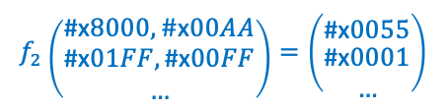
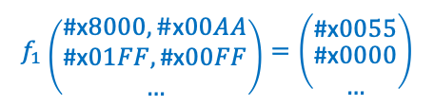

Synthesis by Top-Down Deduction
Semantic specification:
$$f\left({\text{\#}\text{x}8000,\#\text{x}00AA \atop \begin{aligned}\text{\#}\text{x}01FF,\text{\#}\#\text{x}00FF \\ …\end{aligned}}\right)=\left({\text{\#}\text{x}\text{0055} \atop \begin{aligned}\#\text{\#}\text{x}0001 \\ …\end{aligned}}\right)$$
deduce
add
$$?$$
Syntactic constraint:
$$f_{1}\left({\text{\#}\text{x}8000,\#\text{x}00AA \atop \begin{aligned}\text{\#}\text{x}01FF,\text{\#}\#\text{x}00FF \\ …\end{aligned}}\right)=\left({\text{\#}\text{x}\text{0055} \atop \begin{aligned}\#\text{\#}\text{x}0000 \\ …\end{aligned}}\right)$$
add
>>
$$f_{2}\left({\text{\#}\text{x}8000,\#\text{x}00AA \atop \begin{aligned}\text{\#}\text{x}01FF,\text{\#}\#\text{x}00FF \\ …\end{aligned}}\right)=\left({\text{\#}\text{x}\text{0055} \atop \begin{aligned}\#\text{\#}\text{x}0001 \\ …\end{aligned}}\right)$$
E :=
$x$ | $y$ | 0x0000 | 0x00ff | 0x0008 | …
| not E | E and E | E or E | E xor E
| neg E | E add E | E mul E
| E sub E | E udiv E | E sdiv E |
| E urem E | E srem E | E ashr E
| E << E | E >> E | ITE (E = 0, E, E)
$$?$$
$$?$$
$$?$$
$$?$$
$$?$$
$$?$$
Notes:
Currently, there are two classes of synthesis techniques that have been widely used. The first one is enumerative synthesis. Given the SyGuS problem, enumerative synthesis is to systematically enumerate the possible implementations and check if they are the desired ones. The enumeration can follow a size-based order. Or the enumeration order can also be counterexample based, such as CEGIS. The search strategy can also be learning-based. The enumeration approach is generally applicable to different kinds of SyGuS problems, however, it’s very limited in scalability especially when the size of the expected program grows.
The goal of the synthesizer is to search for a candidate program that matches a set of input-output examples.

Slide 11
Efficiency
Deductive synthesis
?
Enumerative synthesis
Generality

Slide 12


Reconciling Enumeration and Deduction
Divide-and-Conquer
strategies
P
Subterm-based
division
Fixed-term-based
division
A
B
Weaker-spec-based
division
AA
AA
BA
BB
AB
BA
BB
Syntax-guided
Deduction
…
Height-based
Enumeration
…
synthesis engines
Kangjing Huang, Peiyuan Shen, Xiaokang Qiu, and Yanjun Wang. [PLDI’20]

Slide 13
How about bit-vectors?

Slide 14
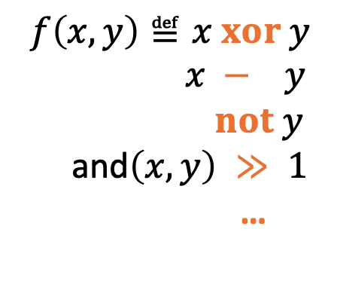

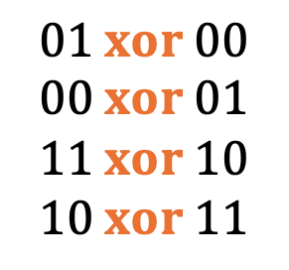

Top-down deduction: too many ways to decompose!
$$f\left(11，10\right)=01$$
$$f\left(x, y\right)≝☐ ?☐$$
$$01 xor 00$$
$$00 xor 01$$
$$11 xor 10$$
$$10 xor 11$$
$$f\left(x, y\right)≝x xor y$$
$x − y$
$not y$
and$\left(x,y\right) ≫ 1$
…

Slide 15












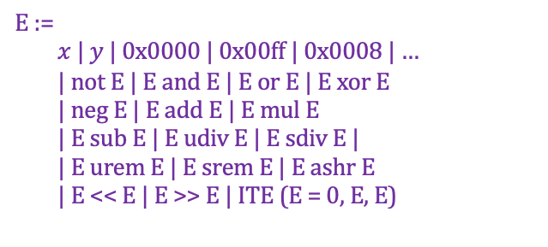






Bottom-up enumeration: exponential blowup!
E :=
$x$ | $y$ | 0x0000 | 0x00ff | 0x0008 | …
| not E | E and E | E or E | E xor E
| neg E | E add E | E mul E
| E sub E | E udiv E | E sdiv E |
| E urem E | E srem E | E ashr E
| E << E | E >> E | ITE (E = 0, E, E)
not$($neg($y))$
neg$($not($x))$
and($x,y$)
add($x,y$)
$$x≪y$$
xor($x,$ #x0000)
mul(#xffff$,y$)
not($x)$
not($y)$
ashr($x,$ #x0001)
not(#x0008)
udiv($y,x$)
neg(#x0008)
sdiv($x,y$)
not(#x0000)
$$x$$
$$y$$
neg(#x00ff)
urem($y,$ #x00ff)
neg($y)$
$$…$$
not(#x00ff)
#x0000
#x0008
#x00ff
neg(#x0000)
neg($x)$

Slide 16













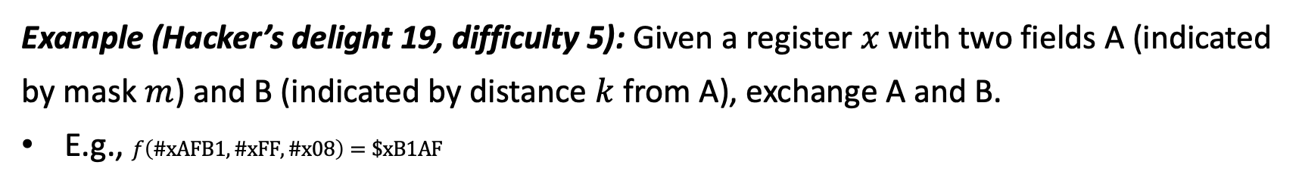

Example (Hacker’s delight 19, difficulty 5): Given a register $x$ with two fields A (indicated by mask $m$) and B (indicated by distance $k$ from A), exchange A and B.
E.g., $f\left(\#xAFB1, \#xFF,\#x08\right)=\$xB1AF$
$$⊨spec ?$$
$$f\left(x,m,k\right) ⊨spec ?$$
$$xor$$
$$xor$$
$$xor$$
#1: Bottom-up deduction
$$?$$
$$?$$
$$E=$$
$$1$$
$$x$$
$$(ξ≪k)$$
$$(x xor ξ)$$
$$\left(x xor ξ\right) xor (ξ≪k)$$
Larger
1264524th
3828868th
≈ 10¹⁴ th
$$ξ≝(m and (x xor (x≫k)))$$

Slide 17
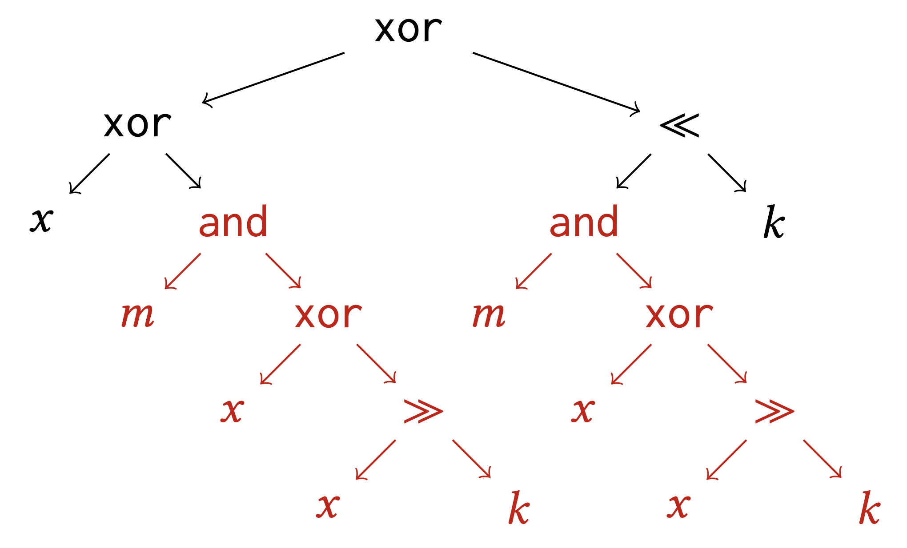
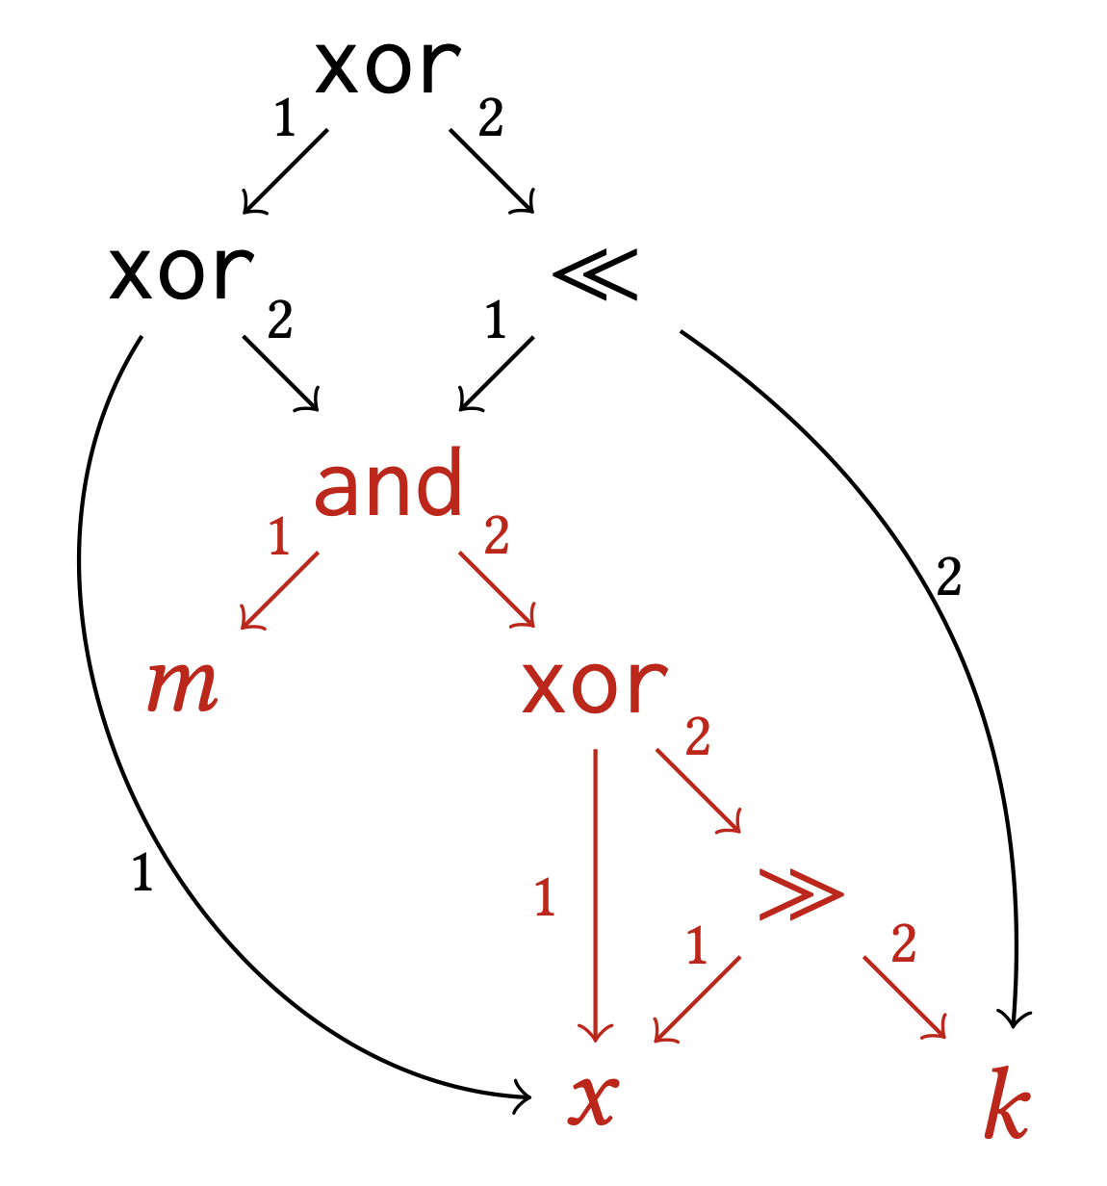
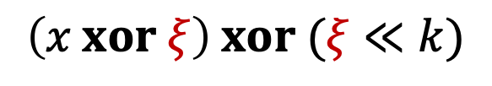
#2: Term-graph-based enumeration
$$\left(x xor ξ\right) xor (ξ≪k)$$
(19 nodes)
(9 nodes)
Yuantian Ding and Xiaokang Qiu. [POPL’24]

Slide 18
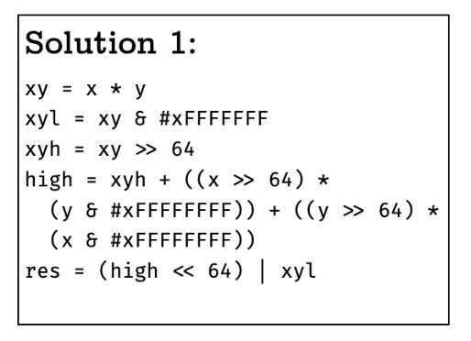
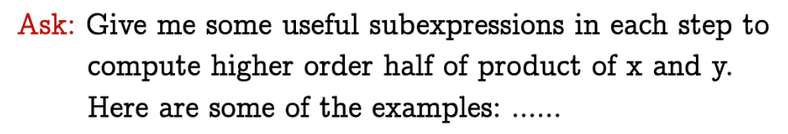
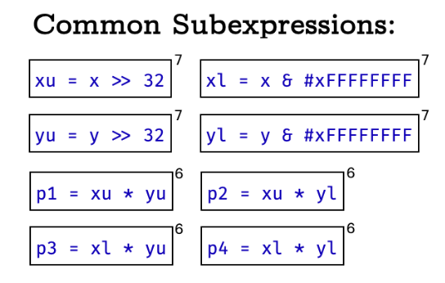
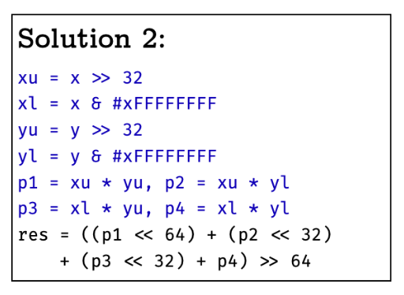

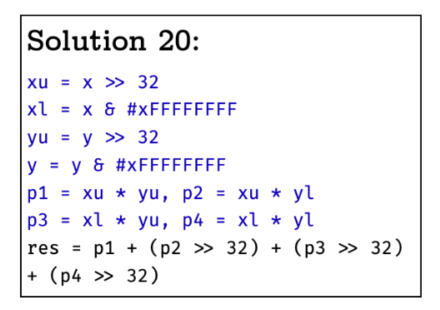
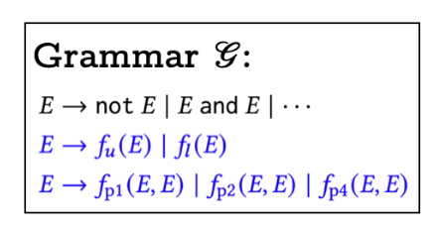
#3: Large language model guidance
hints
$$…$$
Yuantian Ding and Xiaokang Qiu. [POPL’24]

Slide 19
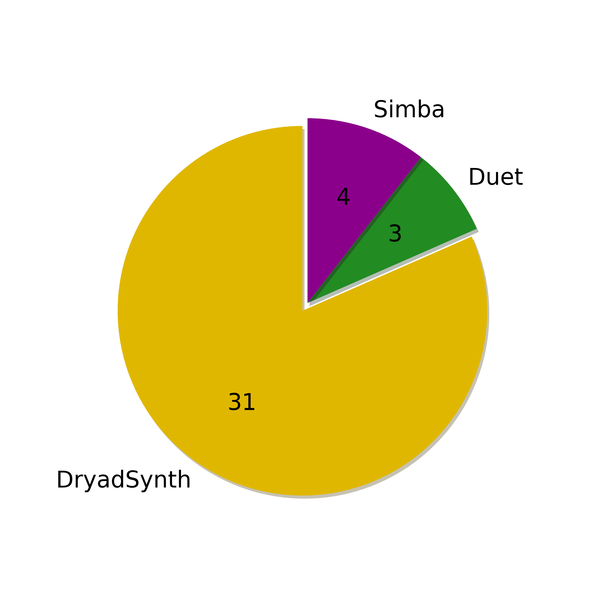
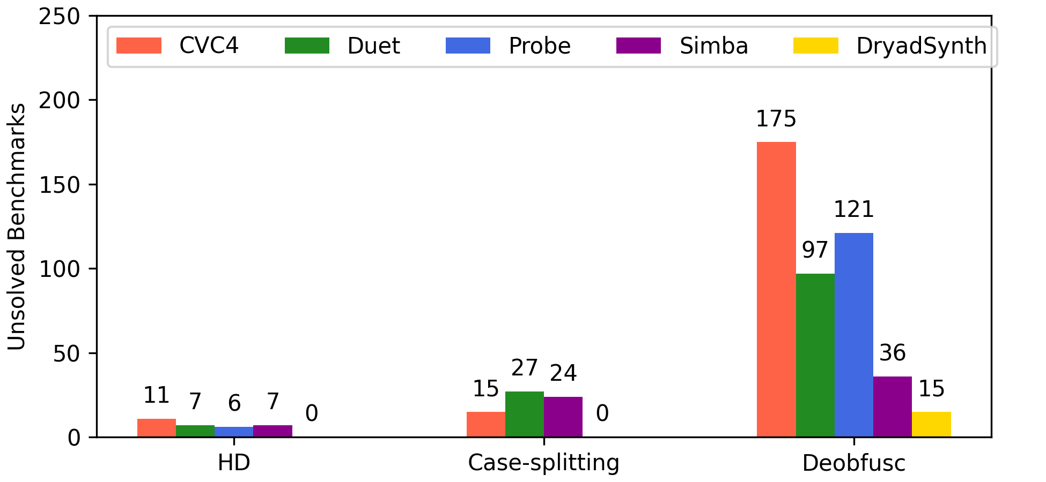
# Unsolved and uniquely solved Benchmarks
Notes:
We sorted the solving time of each benchmark in the ascending order. DryadSynth has better scalability than the other synthesizers. Although we have a constant overhead on the easier-to-solved benchmarks, the solving time increases more mildly toward more challenging benchmarks than other synthesizers.

Slide 20
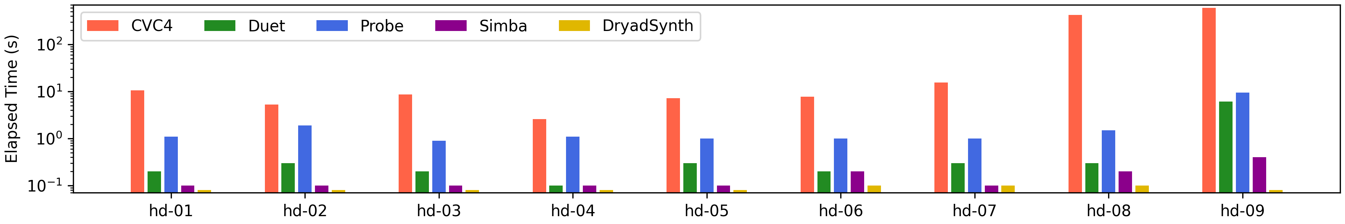
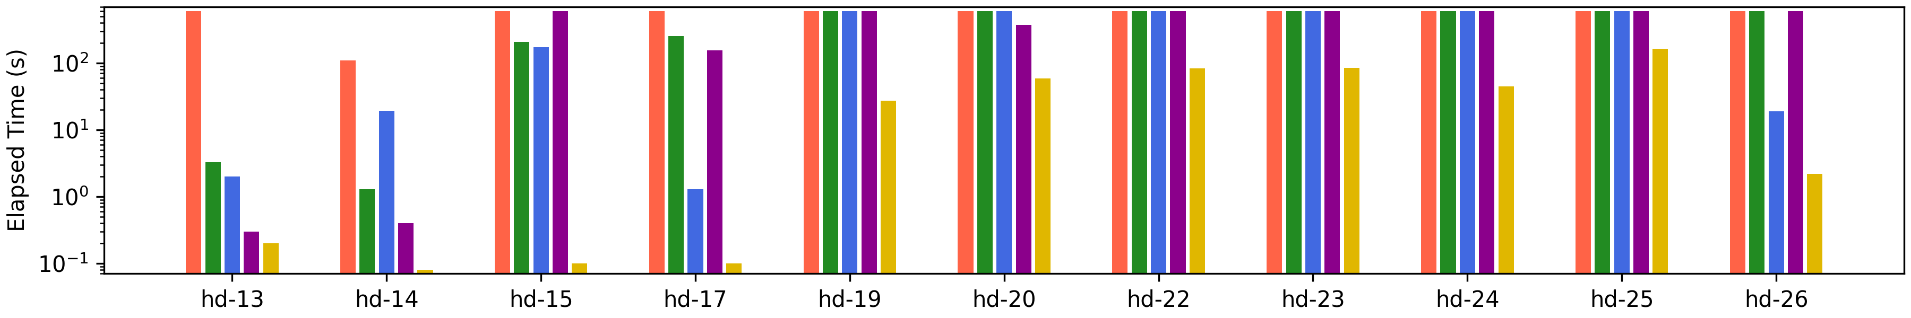
Hacker’s Delight

Slide 21
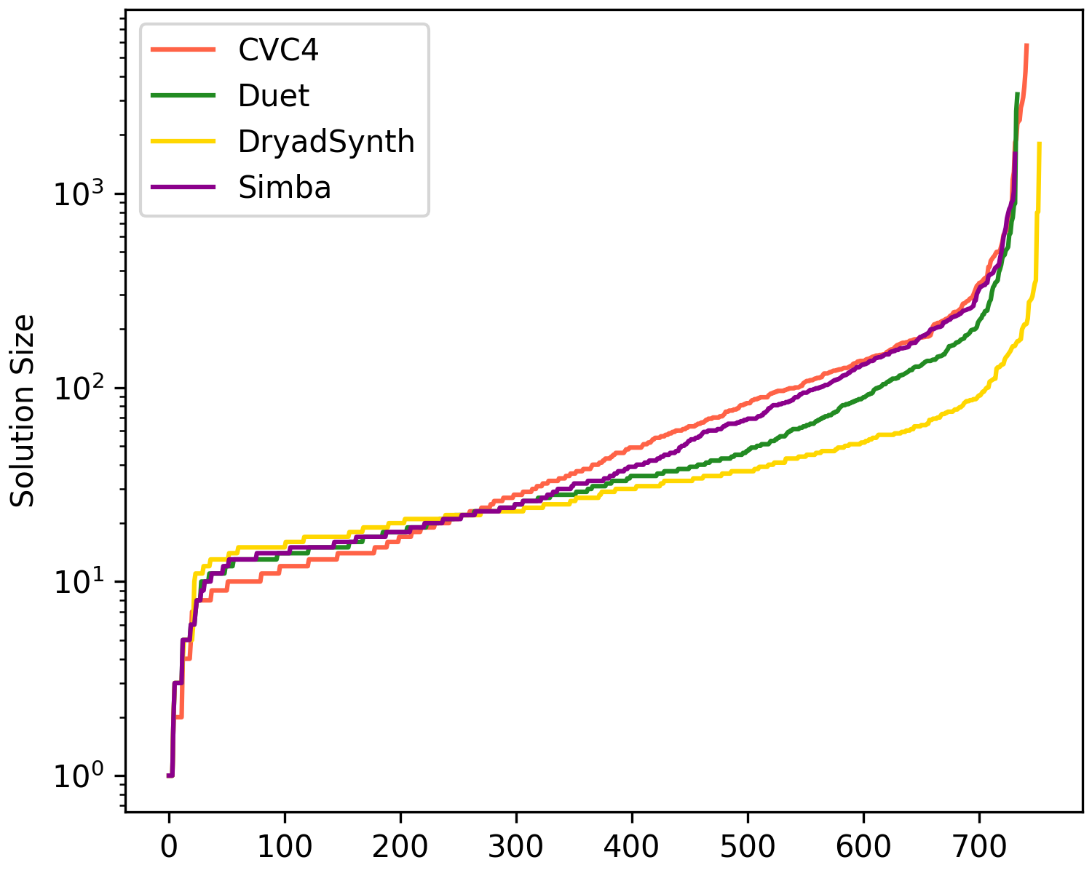
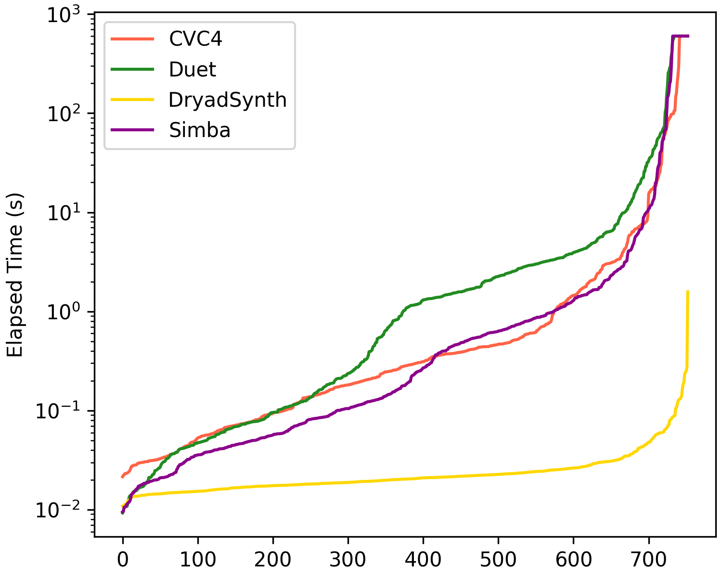
Case-splitting

Slide 22
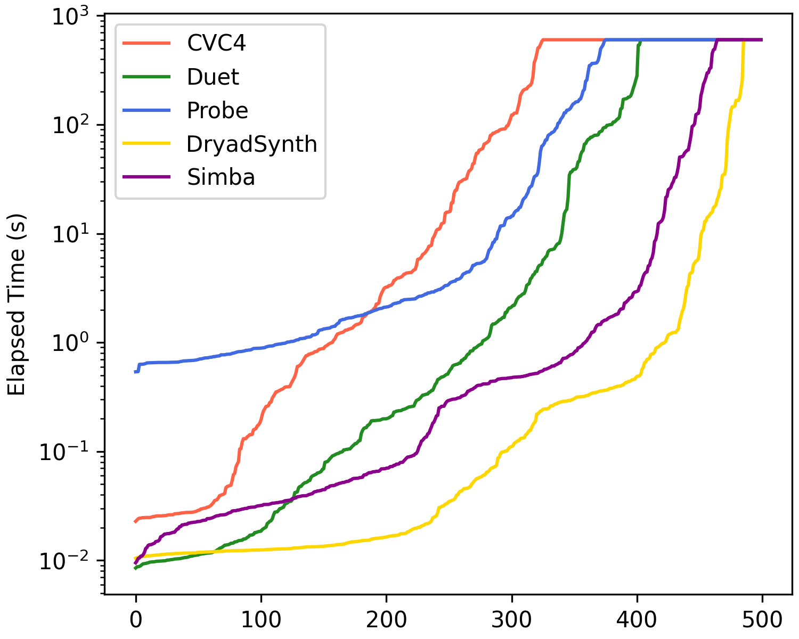
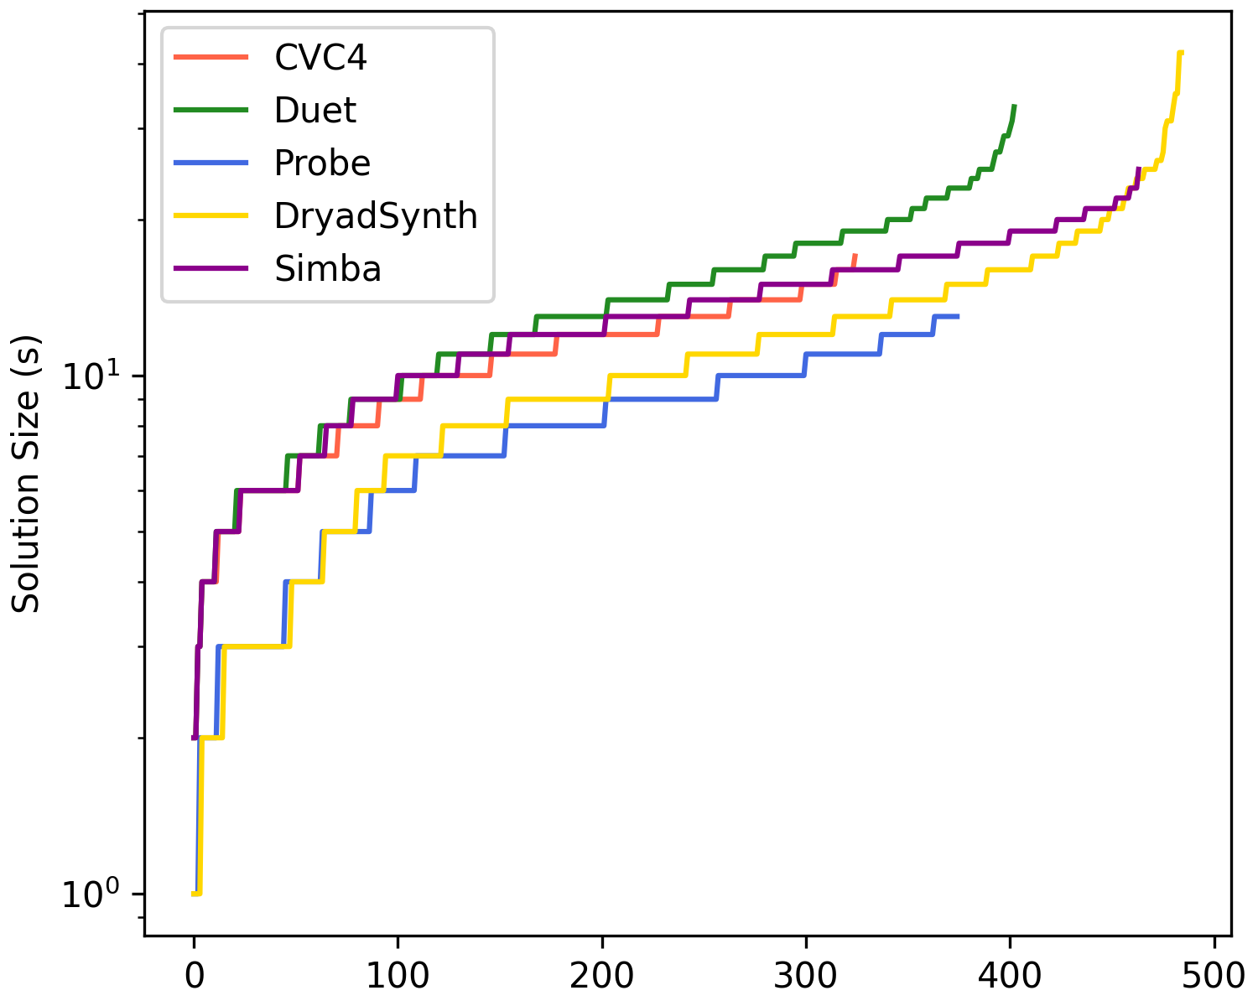
Deobfuscation

Slide 23
How about strings?

Slide 24
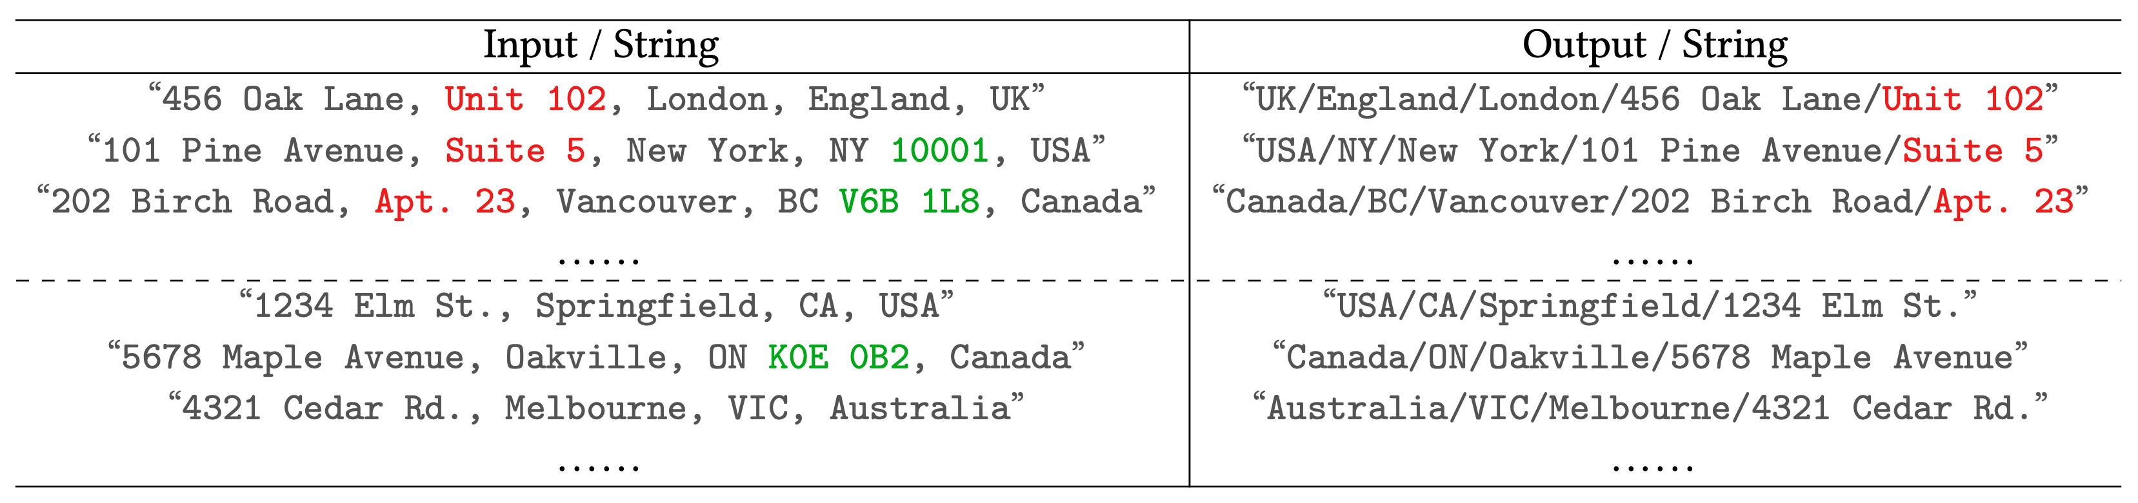

Solution:
(Unsolvable by any existing SyGuS Solver)

Slide 25
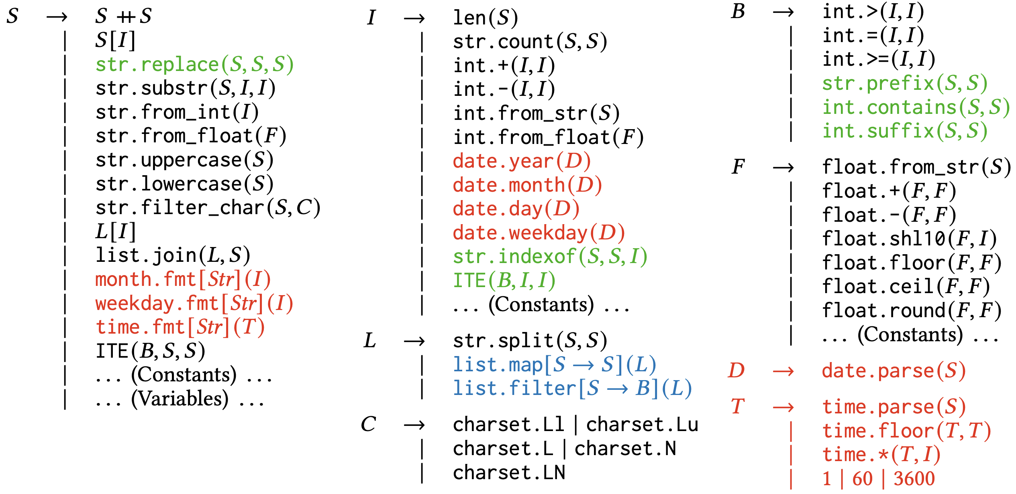
Challenge #1: Rich Grammar

Slide 26

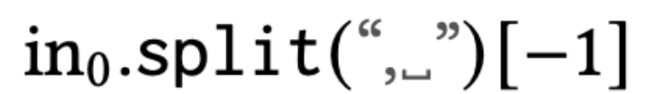
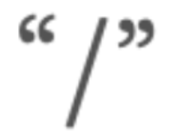
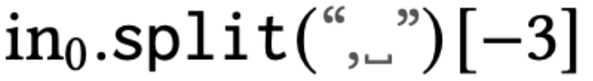
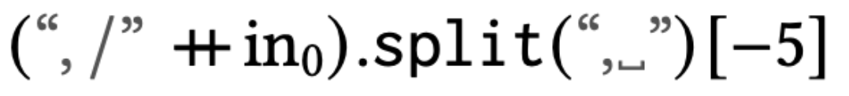
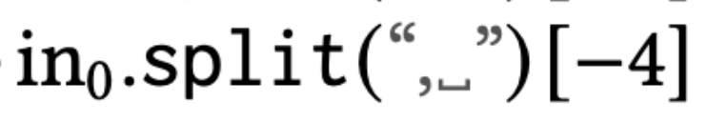
Challenge #2: Nested Decomposition

Slide 27














Concurrent Cooperation
$$P_{1}$$
$$P_{1}$$
OR
$$P_{2}$$
$$P_{2}$$
$$P_{3}$$
AND
AND
$$P_{4}$$
$$P_{6}$$
$$P_{7}$$
$$P_{4}$$
$$P_{5}$$
$$P_{5}$$
Solved
OR
$$P_{9}$$
$$P_{8}$$
$$P_{9}$$
Solved
Enumeration
(Paused)
Yuantian Ding and Xiaokang Qiu. [PLDI’25]

Slide 28
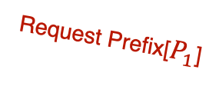

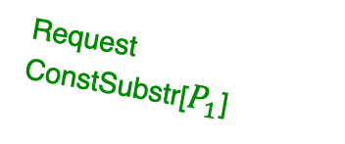
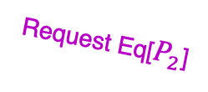




Concurrent Cooperation
Deducer
Enumerator
$$P_{1}$$
“UK/England/London/456 Oak Lane/Unit 102”
“Australia/VIC/Melbourne/4321 Cedar Rd.”
Request ConstSubstr[$P_{1}$]
Request Prefix[$P_{1}$]
…….
Can I have a solution that produces any prefix of $P_{1}$?
Respond “/”
ConstSubstr
“/”
“/”
$$P_{2}$$
[“UK”, “England”, “London”, “456 Oak Lane”, “Unit 102”]
[“Australia”, “VIC”, “Melbourne”, “4321 Cedar Rd.”]
Request Eq[$P_{2}$]
(No Response)
Prefix
Can I have a solution that equal to $P_{2}$?
Respond ${\text{in}}_{0}.split($“/”$)[0]$
$$P_{3}$$
“UK”
“Australia”
“/England/London/456 Oak Lane/Unit 102”
“/VIC/Melbourne/4321 Cedar Rd.”
Yuantian Ding and Xiaokang Qiu. [PLDI’25]

Slide 29
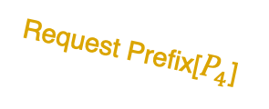




Concurrent Cooperation
Deducer
Enumerator
$$P_{3}$$
“/England/London/456 Oak Lane/Unit 102”
“/VIC/Melbourne/4321 Cedar Rd.”
Request ConstSubstr[$P_{3}$]
Can I have a solution that produces any prefix of $P_{3}$?
Respond “/”
Prefix
“/”
“/”
$$P_{4}$$
[“England”, “London”, “456 Oak Lane”, “Unit 102”]
[“VIC”, “Melbourne”, “4321 Cedar Rd.”]
Request Prefix[$P_{4}$]
…….
Yuantian Ding and Xiaokang Qiu. [PLDI’25]

Slide 30


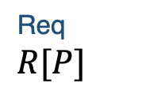




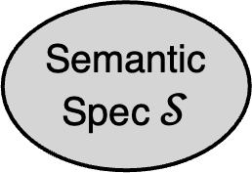
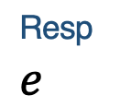

Communication Architecture
Asynchronous Deducer
Specification
Semantic
Spec $𝒮$
Coroutines
Problem
Solution
$$P_{1}$$
$$P_{2}$$
$$⋯⋯$$
$$P_{3}$$
$$P_{4}$$
$$P_{5}$$
$$⋯⋯$$
$$⋯⋯$$
Req $R[P]$
Resp $e$
Versatile Enumerator
Request Handler
Syntactic
Info
Updates
Term
Dispatcher
Term
Generator

Slide 31
“if-then-else” Case-splitting
“USA/NY/New York/101 Pine Avenue/Suite 5”
“UK/England/London/456 Oak Lane/Unit 102”
“Australia/VIC/Melbourne/4321 Cedar Rd.”
“UK/England/London/456 Oak Lane/Unit 102”
“USA/NY/New York/101 Pine Avenue/Suite 5”
“UK/England/London/456 Oak Lane/Unit 102”
“Australia/VIC/Melbourne/4321 Cedar Rd.”
“USA/NY/New York/101 Pine Avenue/Suite 5”
“Australia/VIC/Melbourne/4321 Cedar Rd.”
[“UK”, “England”, “London”, “456 Oak Lane”, “Unit 102”]
[“USA”, “NY”, “New York”, “101 Pine Avenue”, “Suite 5”]
[“UK”, “England”, “London”, “456 Oak Lane”, “Unit 102”]
[“Australia”, “VIC”, “Melbourne”, “4321 Cedar Rd.”]
[“USA”, “NY”, “New York”, “101 Pine Avenue”, “Suite 5”]
[“Australia”, “VIC”, “Melbourne”, “4321 Cedar Rd.”]
Too aggressive split: overfitting
Too conservative split: No solution

Slide 32




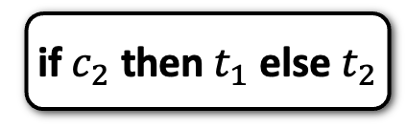
















Accumulative Case-splitting
Solutions/Conditions
Pool
$$c_{2}$$
Asynchronous Deducer
$$e_{1}$$
$$t_{1}$$
$$c_{1}$$
$$\{e_{2},e_{5}\}$$
$$\{e_{1}\}$$
$$\{e_{2}\}$$
$$e_{2}$$
$$e_{3}$$
$$\{e_{1},e_{2},e_{3}\}$$
$$t_{1}$$
$$t_{3}$$
$$t_{2}$$
$$c_{2}$$
$$t_{2}$$
$$c_{1}$$
$$e_{4}$$
$$e_{5}$$
Versatile Enumerator
$$t_{3}$$
Solution
if $c_{2}$ then $t_{1}$ else $t_{2}$
Decision Tree
Learning
Notes:
To address this, we introduce Accumulative Case-Splitting (ACS). The key idea is to decouple the search for conditions (predicates for branches) from the search for terms (the actual transformations).
[Click] First we pick an example set, here is simple {e1}, to construct a thread of the deducer and enumerator, which we call a ACS worker. Each ACS worker focuses on solving this single example set. Multiple ACS worker can run parallelly in multiple threads.
[Click] After we run the ACS worker and get this single example set solved, we got a term t1, which solves {e1, e2, e3}.
[Click] ACS worker also generate conditions at the same time. Here it generates c1, which simples e2 from other examples.
[Click] Then since it is impossible to construct a solution with existing conditions and terms, we continue to create ACS workers. This time, we use {e2} as the example set.
[Click] We got t2 in return, t2 solves {e1, e2, e3, e4} but not e5. This time still, it is impossible to construct a solution using existing conditions and solutions.
[Click] Now we need to pick another set of example, this time we pick {e2, e5}, since e2 and e5 can not be solved within a single term. And then we run the ACS worker for a while.
[Click] This time we have t3, it solves e2, e3, e4, and e5 but not e1. Still, it is impossible to construct a solution using existing conditions and solutions. So we continue to search.
[Click] We use e1, e2, e5 this time, since it can not be solved jointly. Running the ACS worker for a while.
[Click] we got a condition c2, which splits e3, e5 out of other examples. This time, a solution is able to be constructed using c2, t1, and t2.
[Click] We perform a decision tree learning to generate a solution, here the solutions is simply if c2 then t1 else t2. But in more complex cases, it will generate a decision tree of conditions and terms to solve the problem.
This we case-splitting is decoupled from deduction, which effectively reduces the deduction search space.

Slide 33





Accumulative Case-splitting, Concurrently
Solutions/Conditions
Pool
$$c_{2}$$
ACS
Worker
Asynchronous Deducer
$$t_{1}$$
Spawn
$$e_{1}$$
$$𝒮_{1}$$
$$c_{1}$$
$$⋮$$
$$e_{2}$$
$$e_{3}$$
Spawn
Spawn
ACS
Worker
$$𝒮_{n}$$
$$𝒮_{n}$$
$$t_{2}$$
$$⋮$$
$$e_{4}$$
$$e_{5}$$
Versatile Enumerator
$$⋮$$
$$t_{3}$$
Notes:
To address this, we introduce Accumulative Case-Splitting (ACS). The key idea is to decouple the search for conditions (predicates for branches) from the search for terms (the actual transformations).
[Click] First we pick an example set, here is simple {e1}, to construct a thread of the deducer and enumerator, which we call a ACS worker. Each ACS worker focuses on solving this single example set. Multiple ACS worker can run parallelly in multiple threads.
[Click] After we run the ACS worker and get this single example set solved, we got a term t1, which solves {e1, e2, e3}.
[Click] ACS worker also generate conditions at the same time. Here it generates c1, which simples e2 from other examples.
[Click] Then since it is impossible to construct a solution with existing conditions and terms, we continue to create ACS workers. This time, we use {e2} as the example set.
[Click] We got t2 in return, t2 solves {e1, e2, e3, e4} but not e5. This time still, it is impossible to construct a solution using existing conditions and solutions.
[Click] Now we need to pick another set of example, this time we pick {e2, e5}, since e2 and e5 can not be solved within a single term. And then we run the ACS worker for a while.
[Click] This time we have t3, it solves e2, e3, e4, and e5 but not e1. Still, it is impossible to construct a solution using existing conditions and solutions. So we continue to search.
[Click] We use e1, e2, e5 this time, since it can not be solved jointly. Running the ACS worker for a while.
[Click] we got a condition c2, which splits e3, e5 out of other examples. This time, a solution is able to be constructed using c2, t1, and t2.
[Click] We perform a decision tree learning to generate a solution, here the solutions is simply if c2 then t1 else t2. But in more complex cases, it will generate a decision tree of conditions and terms to solve the problem.
This we case-splitting is decoupled from deduction, which effectively reduces the deduction search space.

Slide 34
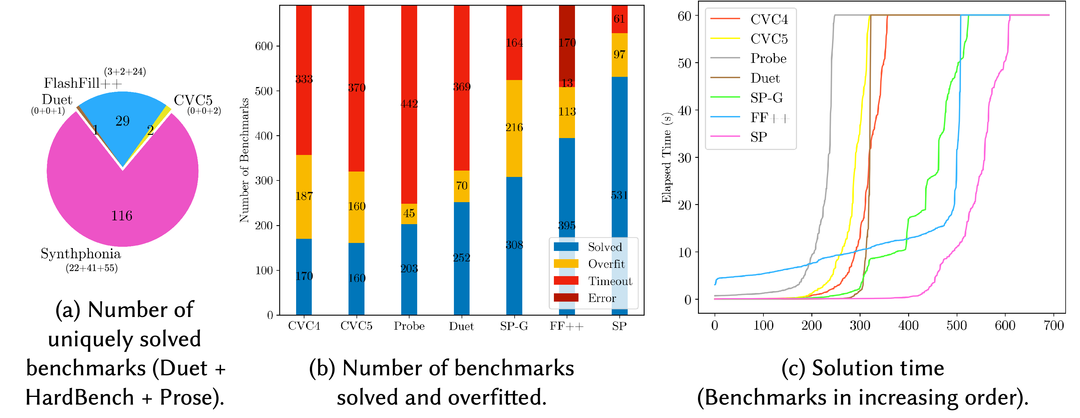
Experimental Results

Slide 35
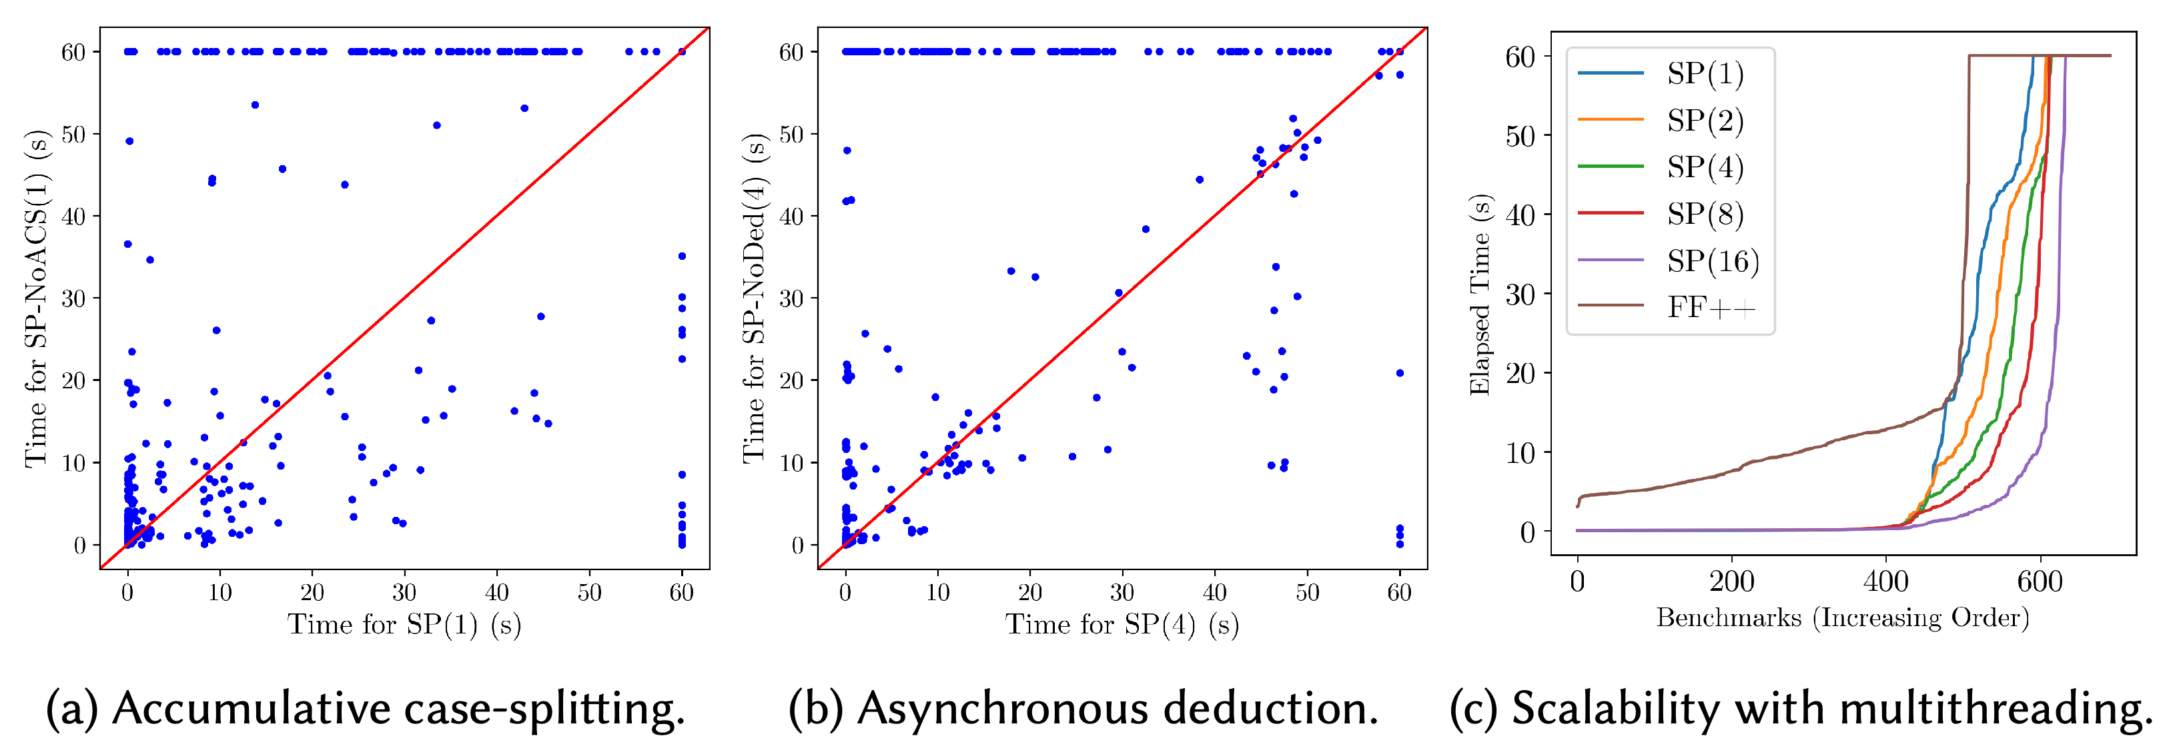
Ablation Study

Slide 36

Thank you!
Try DryadSynth at: https://cap.ecn.purdue.edu/dryadsynth

